Slide 1





This File Cabinet represents your Site or Subsite
2
Within each CHANNEL
(DRAWER), is one or more
hanging folders or
SECTIONS
1
Each CHANNEL is
like a DRAWER-
containing similar
information.
3
Within each SECTION
(Folder) are the
PAGES of information
about that section.

Slide 2
Passports
Passports
A set of extended administrative privileges that can be assigned to users
with or without Editing Privileges
Passport Examples:
Calendar Assets
Includes the extended privilege of creating the calendar categories and collections.
Section Assets
Includes the extended privileges of creating & maintaining Editor Layouts Section Configurations
User Mgmt.
Includes the extended privileges of managing all
Users & Groups functionality.

Slide 3
Editing Privileges
Entire Website
District/Main Site
SITE DIRECTOR
Channel
Director
Section
Editor
Section
Editor
Section
Editor
Section
Editor
Homepage Editor
Subsite
Subsite
SUBSITE DIRECTOR
SUBSITE DIRECTOR
Channel
Director
Section
Editor
Section
Editor
Channel
Director
Section
Editor
Section
Editor
Section
Editor
Section
Editor
Section
Editor
Section
Editor
Homepage Editor
Homepage Editor

Slide 4
Collections
Group calendars from sites, channels, and sections into Collections. These Collections enable the ability to post calendar events to the calendars within the Collection
Collection Examples
  District calendar (so schools & sections can share events)
  All school calendars
  Elementary school calendars
  Athletic team calendars
  12th grade teacher calendars

Slide 5

Collections Procedure for Calendars equal to or above:
Events Require Approval
District Calendar
Events Require Approval
School Calendar
Events Require Approval
Originating Calendar
(Teacher A Calendar)
Teacher B
Calendar
Teacher C
Calendar
Teacher D
Calendar

Slide 6
Collections Procedure for Calendars below:
Originating Calendar (School Calendar)
Events Automatically Push Down
Teacher A
Calendar
Teacher B
Calendar
Teacher C
Calendar
Teacher D
Calendar

Slide 7
III. Add / Edit your section
Page Layout, Columns, Apps
Page Layout
The way in which the columns are arranged on a page is called the Page Layout. You can have one, two or three column layouts as well as layouts with a left or right side-bar.
Column 1
Column 1
Column 2
App 1
App 2
Columns
You place your apps into the columns of a page layout. You can place one or more apps in a column.
App 3
Apps
Apps are the content building blocks of any Schoolwires page. You can have one or more apps on a page. You can edit your apps as well as share them with other editors. The Flex Editor App and Calendar App are just part of the app library available to you.

Slide 8
Schoolwires Default Page Types
Flex Editor
Article Library
File Library
Link Library
Assignments
Maps and Directions
Calendar
Blogs
Podcasts
Photo Gallery
Using different app and page types keeps your sections interesting and organized!

Slide 9
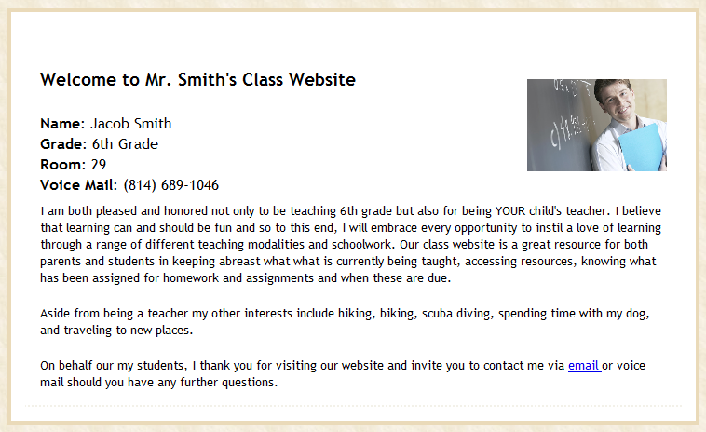
Flex Editor
Place text and images anywhere
Choose an Editor Layout
Insert tables
Insert Links
  Quick links to websites
  To email
  To other areas within the site

Slide 10
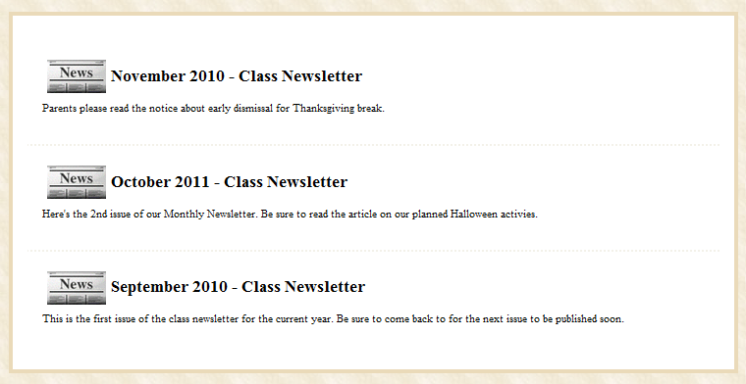
Article Library
An archive of articles
Clickable links that save space
RSS Feeds
Accent Images
Use for
  Weekly newsletters
  Homework
  Sports highlights

Slide 11
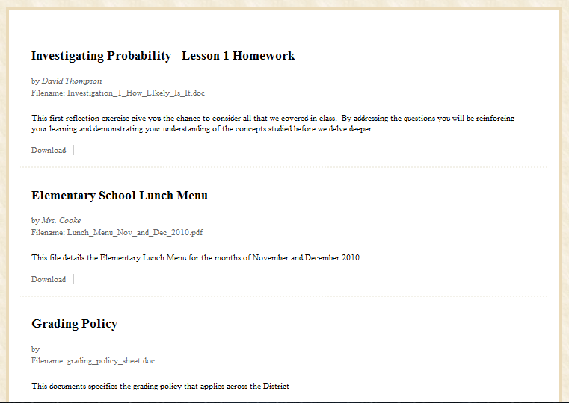
File Library
Post documents for views to download and print
RSS feed available

Slide 12
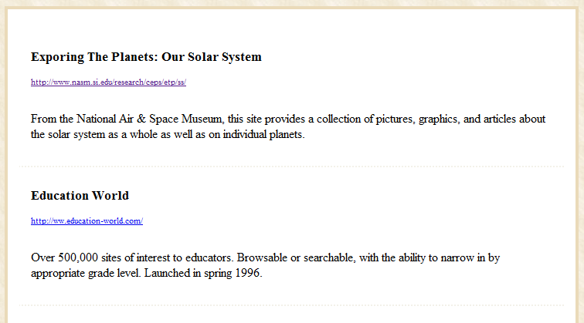
Link Library
Organize useful websites
Title them
Add a description

Slide 13
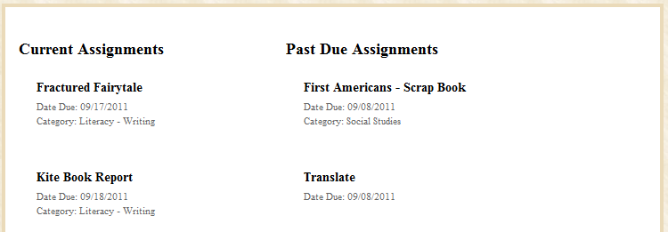
Assignments
Assign or filter by categories
Add the assignment to a calendar
Insert images, links or files

Slide 14
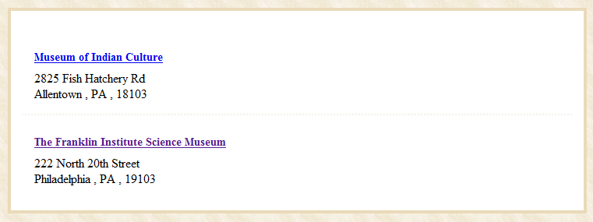
Maps & Directions
Clickable links with directions
Retrieve maps from Google Maps

Slide 15
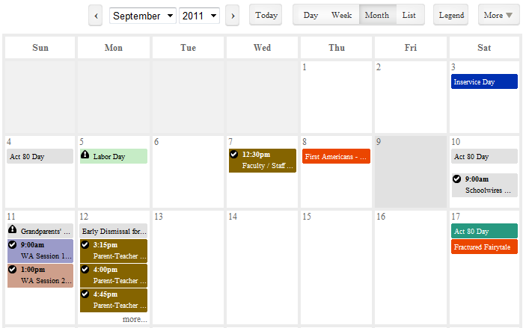
Calendar
Post information specific to your classroom or activity
Request that your events be posted on other calendars
Choose from color-coded categories
Create event registration
Send e-alerts

Slide 16
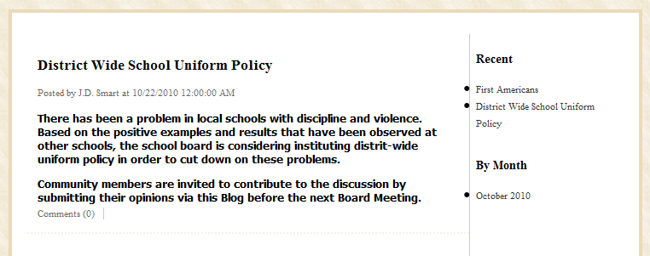
Blogs
Post several entries on the same page – Most recent posts are displayed at the top of the page.
Allow comments to be posted.
Choose to moderate comments or have them display automatically.

Slide 17
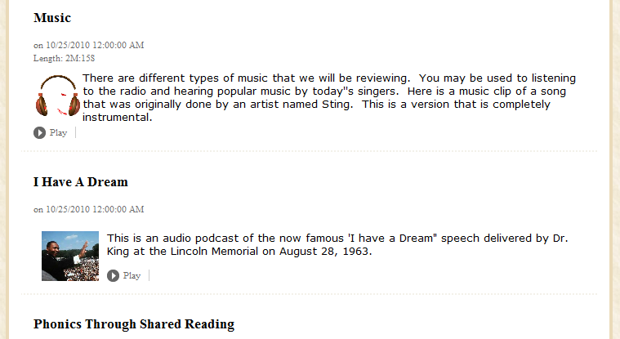
Podcasts
Post several episodes on the same page.
Title and add a description for each episode.
RSS feed and iTunes® feed available.

Slide 18
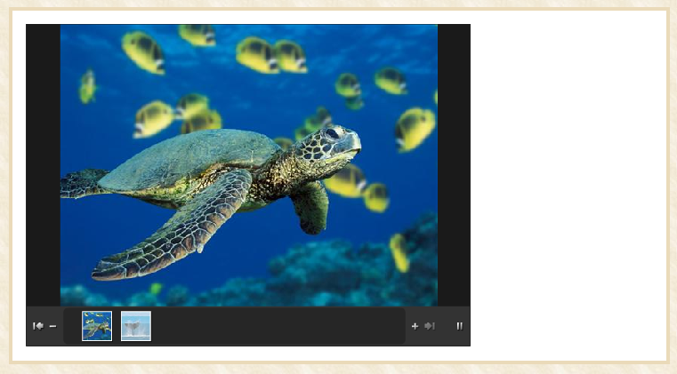
Photo Gallery
Create a slideshow highlighting classroom activities, athletic and other events.
Add audio to your gallery.

Slide 19
Content Moderation
Allows content to be reviewed prior to appearing live on your website.
You can configure Content Moderation for two different scenarios:
  Choose workspaces that are ALWAYS moderated.
  Set combinations of workspaces & editors requiring moderation. (This is useful when you have workspaces that require approval for only some editors.)

Slide 20
Assigning Groups to Group Categories
GROUP CATEGORY:
Rolling Ridge High School
GROUP A:
High School Students
GROUP C:
Math Teachers
GROUP B:
All High School Teachers
Users
Users
Users

Slide 21
Assigning Users to Groups
USERS
GROUP A:
High School Students
GROUP B:
All High School Teachers
GROUP C:
Math Teachers

Slide 22
Users with ONLY Passport Privileges
Site Administrator
User
Administrator
Section
Assets
Calendar
Assets

Slide 23
Users with Passport Privileges AND Editing Privileges
Site Director
Subsite Director
Site Administrator
Channel Director
User
Administrator
Section Editor
Section
Assets
Calendar
Assets

